Slide 1

ELSA Workshop
Day One – Session Two
ELSA is funded by the Australian Government Department of Education and Training through the National Innovation and Science Agenda

Slide 2
What is Early Learning STEM Australia?
Overview of the pilot

Slide 3
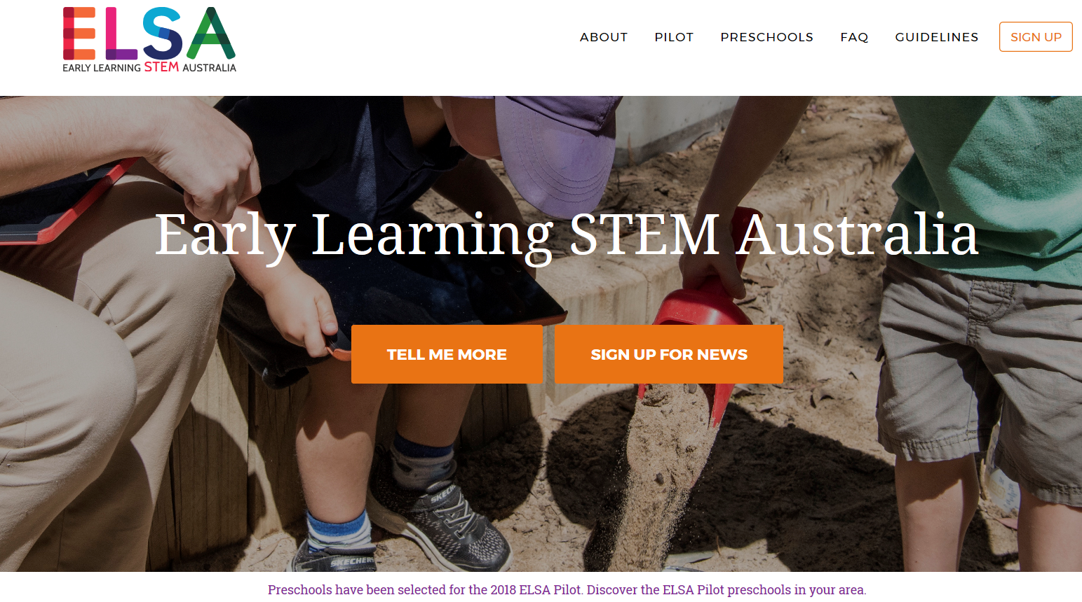
ELSA builds interest and enthusiasm for STEM

Slide 4
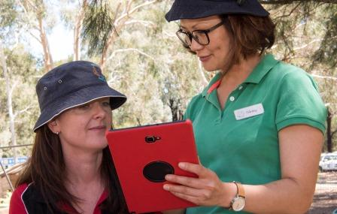
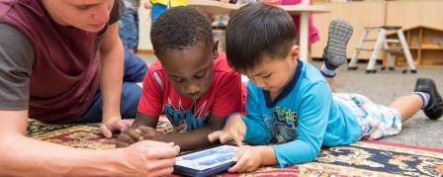
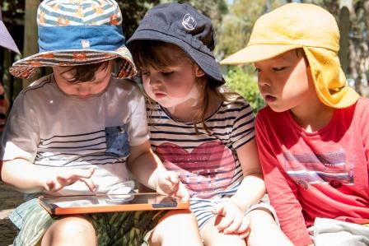
ELSA is built on community involvement

Slide 5
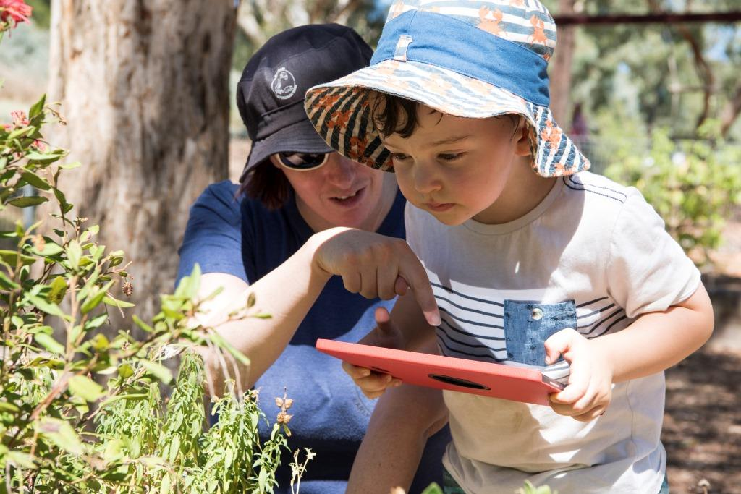
ELSA - a program to inspire

Slide 6
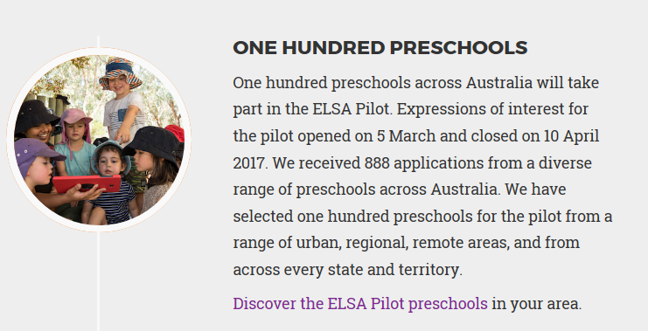
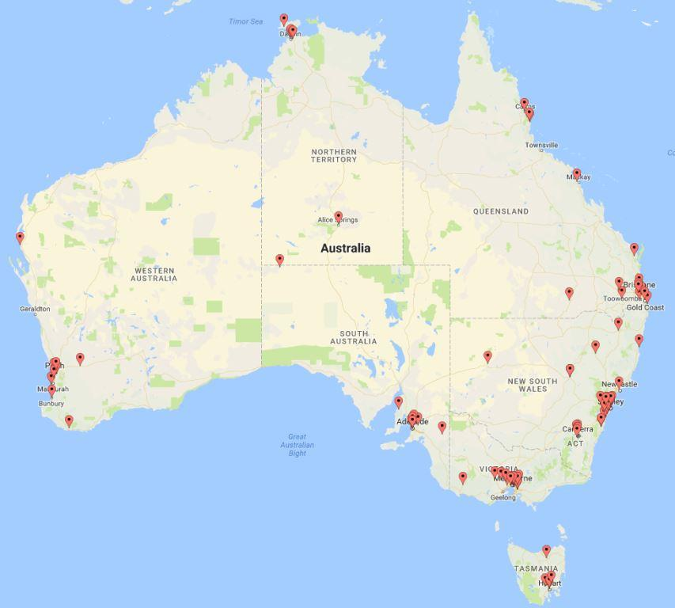
ELSA 2018: one hundred pilot preschools

Slide 7
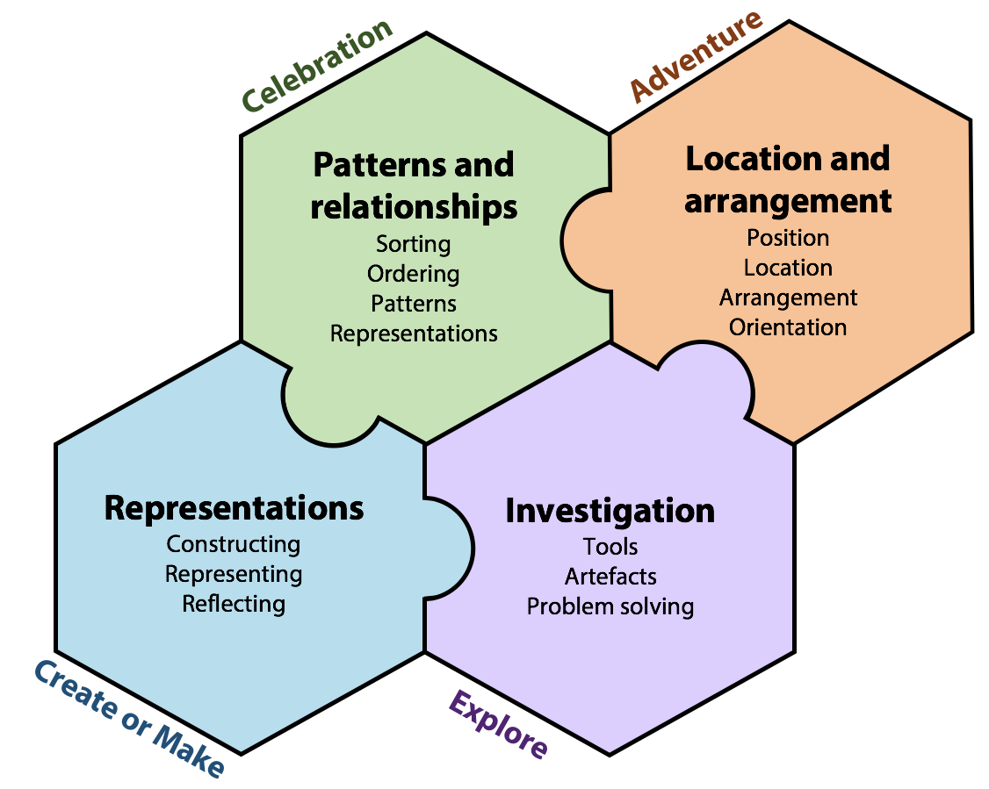
ELSA 2018: our journey
Notes:
Broadly speaking
– Patterns and Relationships will be ready (DATE) – roughly Term One
– Location and Arrangement will be ready (DATE) – roughly Term Two
– Representations will be ready (DATE) – roughly Term Three
– Investigation will be ready (DATE) – roughly Term Four
Educator App will be ready Term One
Families App will be ready roughly -

Slide 8
ELSA timeline
 | 2018
Educator app | January 2018
Children’s App 1 | Beginning of Term 1
Family app | Term 1
Children’s App 2 | Beginning of Term 2
Educator workshop | May/June
Children’s App 3 | Beginning of Term 3
Children’s App 4 | Beginning of Term 4

Slide 9
ELSA apps in practice
App One – Patterns and Relationships
Notes:
You may be wondering why, in a program about Apps, that you haven’t touched an iPad yet. I will tend to say iPad – however the apps will also run on Android devices. Most centres seem to have iPads. SHOW OF HANDS
This is deliberate reflection of our approach to using apps – they become part of the ecology of your preschool – to be used to supplement what you are doing with the children – and to value add – so the patterning app for instance allows for complexity to match the development progression of students.
Rob will talk later about Experience (what happens before the children use the apps) | Represent (what happens when the children are using the apps) | Apply (what happens after the children use the apps).
So when we refer to APP ONE – we are not only referring to the digital activities – but rather the wealth of experiences and applications that you will engage children with in the centre – and at home with their families.

Slide 10
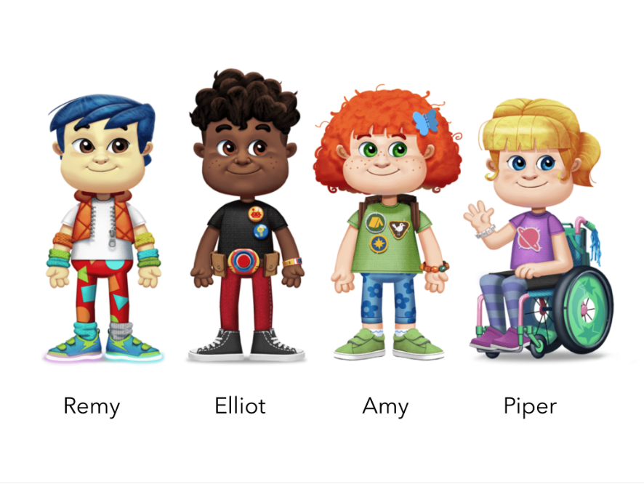
Meet the gang

Slide 11
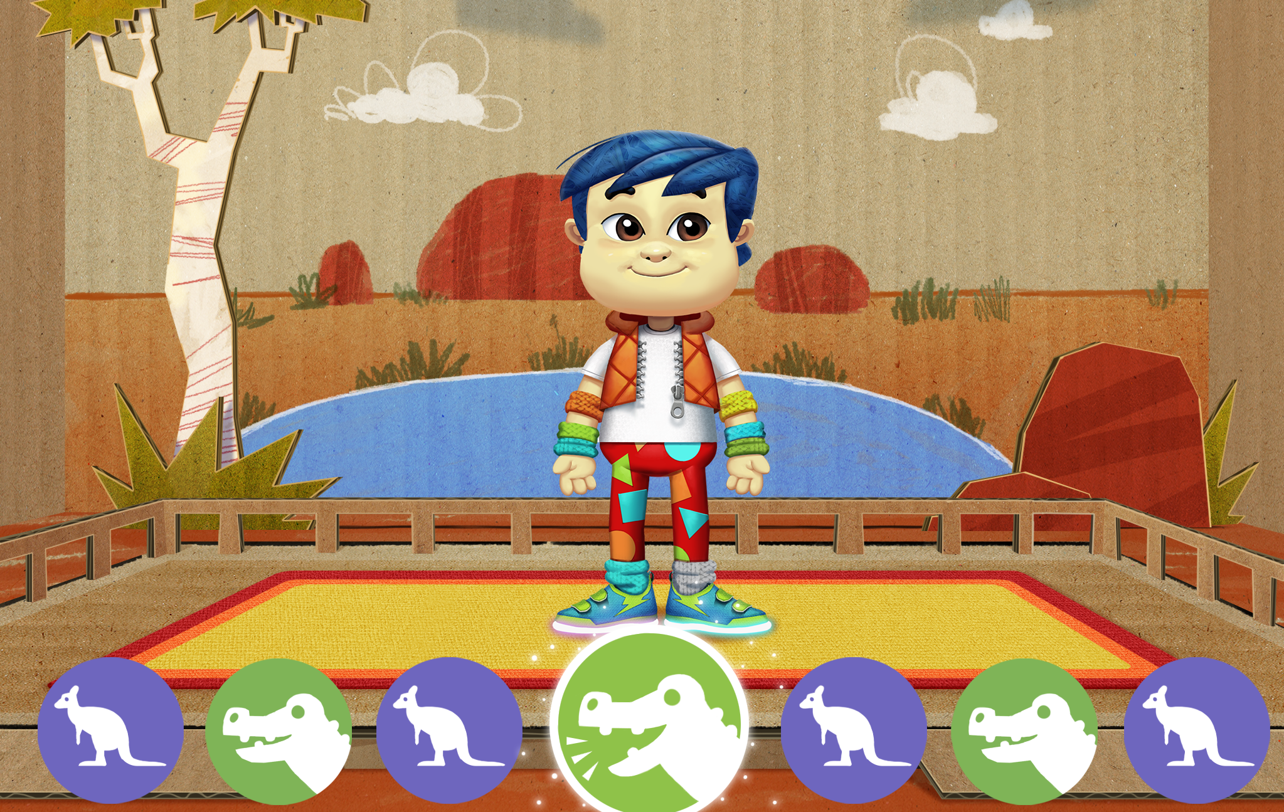
Let’s Dance - Representing
Notes:
There will be three dances ready for Term One – we have one ready in rough form for you to test today.
We will also incorporate dance in App 3
IF we haven’t done so introduce the four ELSA characters.

Slide 12




Let’s Dance – Out in the Australian Bush
Chorus 1
Chorus 2
Chorus 3
Chorus 4
Notes:
Here are the moves for the chorus in Song One.
In the verse you are free to dance your own moves
We will link this to patterning at a later stage.

Slide 13
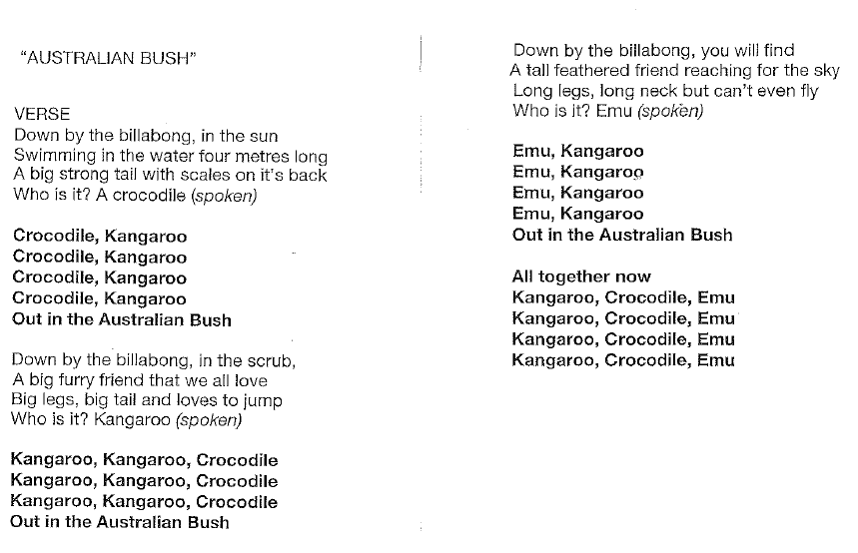
Let’s Dance – Out in the Australian Bush

Slide 14
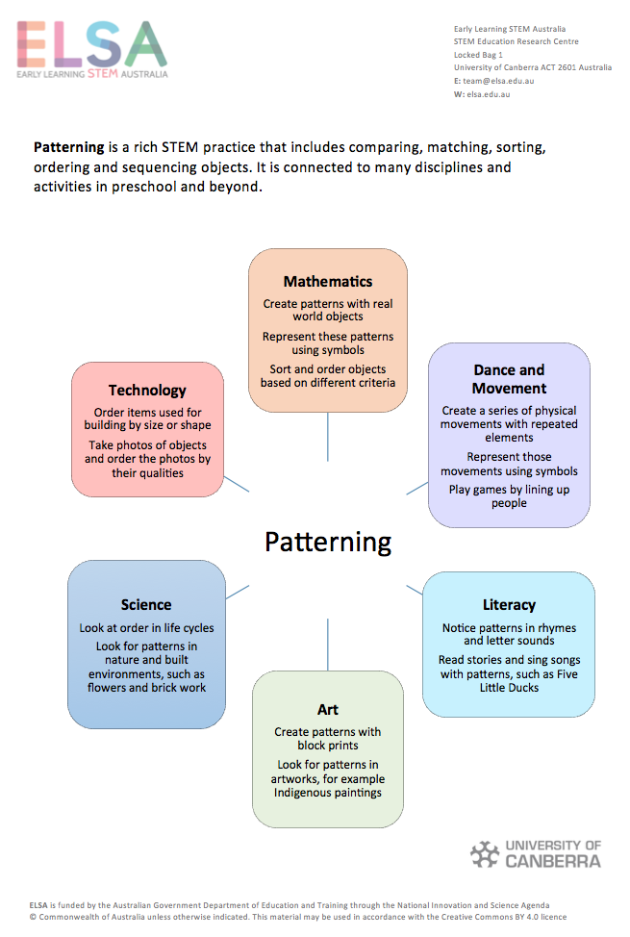
Describing attributes, comparing, ordering, sorting, creating, and representing are all elements of patterning, a rich STEM practice, that involves ourselves and objects in our world. It connects to many activities in preschool and beyond.
Notes:
Early patterning is very important for later learning.

Slide 15
Showing what I have done
Representing
Creating with objects
Patterning
Same and different
Comparing and ordering
Me and other things
Describing Attributes
Patterns and Relationships
Notes:
We see the children experiencing a range of opportunities starting with
Language and describing themselves and things in their world
THEN – Becoming more sophisticated in comparing, matching, ordering and sorting things in their world
THEN – Using their knowledge of objects to be able to copy, extend, fix and create patterns
AND FINALLY – Represent the patterns they have created in movement (dance) and drawing.

Slide 16
How can I show what I have done with my body? With objects? Representing
What can I do? With my body? With objects? Patterning
How are we the same and different? How are objects the same or different?
Comparing
What am I like? What are other things like? What can I do? Describing Attributes
Patterns and Relationships
Notes:
This is the nested model with explanatory questions
It is a nested model as children will likely need to Describe things first | then compare and order | then complete patterning activities | then represent their patterns.

Slide 17
Children’s App 1
Four activities to engage with based on the four areas of conceptual development
Picture book corner (Ordering)
What’s in our lunch box? (Sorting)
Let’s decorate (Patterning)
Let’s dance (Representing)
Before lunch we will have a play with App One – but here is a sneak peak.

Slide 18
Patterns and Relationships: What do we mean?
Sorting
Ordering
Patterning
Representing
Sorting is an important way of thinking logically. It is the idea that items in a group share a common attribute e.g., colour, shape, size, type of food, number, etc.)
Patterns can be found in ideas, words, symbols, numbers, and images. Recognising and later fixing and creating various patterns (AB or ABB or ABC patterns etc.)
What comes first, next, and last? Determining the magnitude (amount) of an attribute and then arranging the objects in order (also order events according to when they occurred e.g. breakfast, lunch, dinner)
Representing a pattern using movement is an important skill for young children. The various dance moves are combined in different ways to represent different patterns.
Notes:
Here is what we mean by the four activities – we will play some games shortly so that you can experience these activities – we have already done the representation in the dance.

Slide 19
Ordering and Sorting – Core Ideas
Attributes. Attributes are qualities an object has. Attributes are used for ordering, sorting and patterning activities.
Ordering (Seriation). Seriation is arranging objects in order by size, location, time or some other measurable attribute.
Double Ordering (Double Seriation). Double Seriation combines the skills of seriation and matching and occurs when two corresponding sets are both in order on the same attribute.
Sorting. Sorting is the idea that items in a group share a common attribute. The three D’s of sorting are Decide on the attribute to sort upon (e.g. colour); Do the sort; and Describe the sort (e.g. here are all the red things, blue things etc.)
Notes:
Demonstrate each of these quickly with materials on their tables.
They will use these skills in the two games.

Slide 20
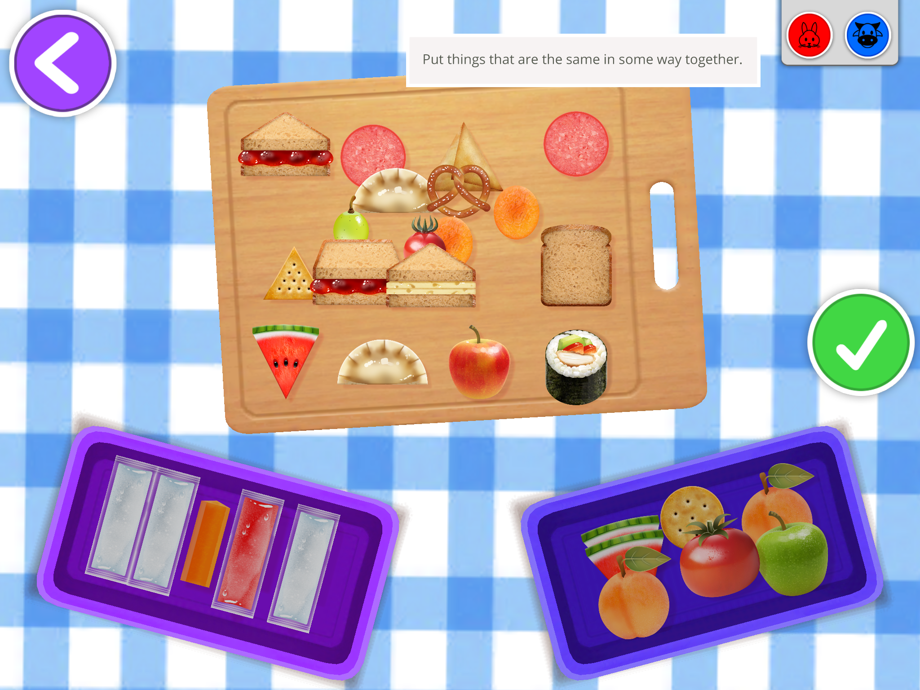
What’s in our lunch box - Sorting
Notes:
Have a look at the illustration – the children have sorted things into the lunch boxes according to what they have in common.
How do you think each child has sorted the food?
When we look at the app shortly you will see that the children have the opportunity to take photos and to talk about how they have sorted the food.

Slide 21
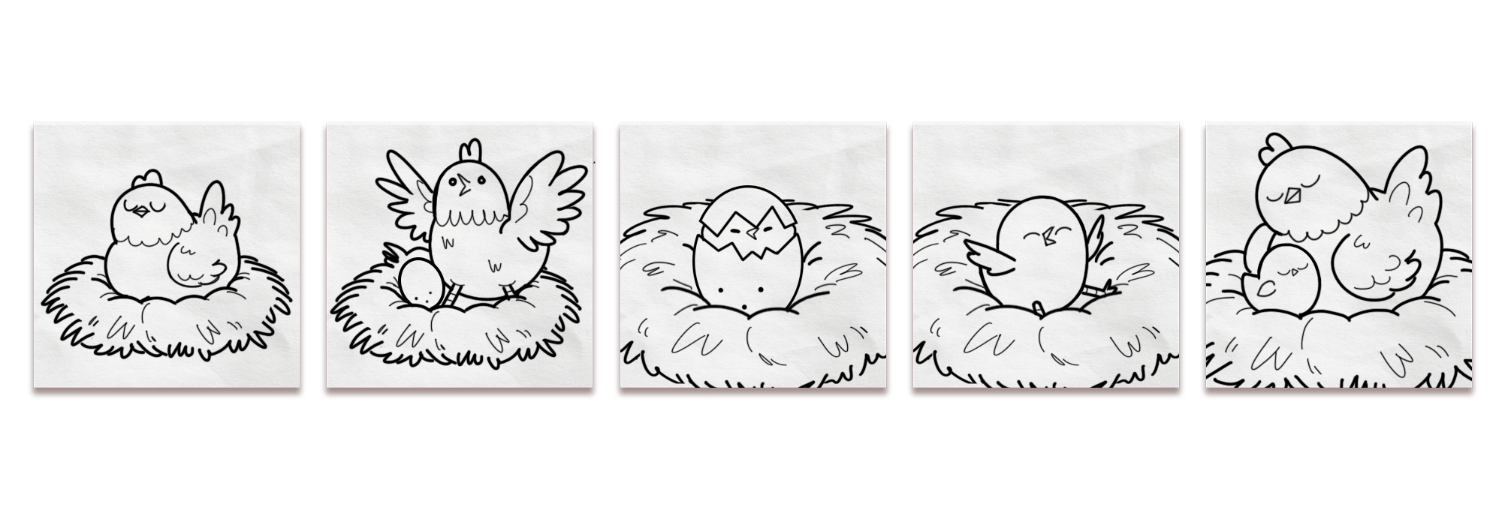
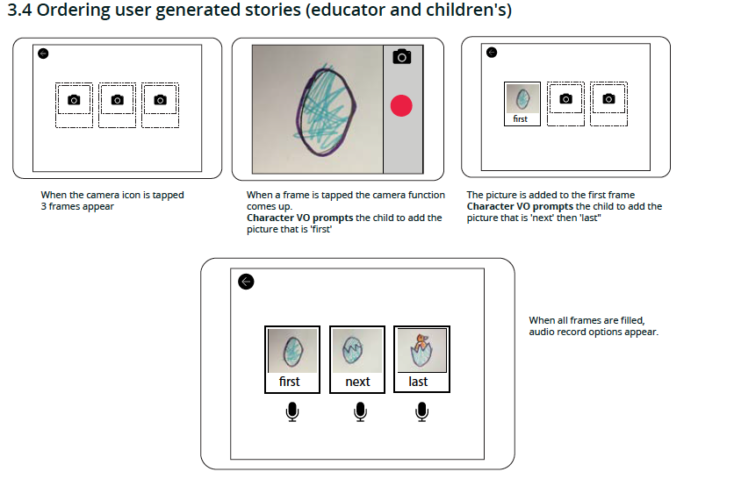
Picture Book - Ordering
Notes:
Here the children initially sort pre-loaded stories into chronological order. At the conclusion of each story they have the opportunity to trace over one of the illustrations and as they do so the images will become coloured.
Also, and most importantly, you can create your own stories for the children to order, or they can create their own stories for their friends to order using the camera and microphone function on the devices.
Again, you can have a go soon.

Slide 22
Let’s Play
The next two activities will engage you with two of the four areas of conceptual development
Attributes and Ordering – Modified Match a Track Game
Sorting – Attribute Blocks Game
You will play one or the other
Share at lunch your game
Notes:
Modified Track Game – before hand get the cards sorted into piles of about 12 matched pairs – if we have enough versions of the games –
Explain the three activities. = Attributes, Matching and Ordering – Do this first and get them started
In each small group: 1) Select an Animal card - Describe the animal using as many attributes as you can; 2) Select a footprint card - Describe the attributes; 3) Could they be a match - work with your friends; 4) Check the answer key; 5) Order your collected cards in some way on an attribute with magnitude.
Sorting – Attribute Blocks - now work with these guys
= Sorting Game. Work with educators on the four attributes - colour, shape, size and thickness. Do some single and double sorts with them - then play the attribute game. One attribute first and then later two attributes.

Slide 23
Patterning – Core Ideas
In ELSA, when we use the word patterns we mean an object or a group of objects that repeats again, again and again.
Copying a pattern. Children are shown a pattern e.g. big marble, small marble | big marble, small marble etc. & copy the pattern using marbles
Extend a pattern. Children can be shown a pattern of frogs: red, blue, green | red and they keep the pattern going.
Missing item or items in a pattern. Children are shown a pattern with a missing element or elements (leaf, twig, seed | leaf, ___, seed) and have to insert the missing element to fix the pattern.
Abstract a Pattern. Abstract a pattern indicates that a pattern is repeated but it is represented in a different form. For example, big car, little car | big car etc. becomes big jump, small jump | big jump small jump etc.
Notes:
Quickly demonstrate what I mean by each of these core ideas using resources they have available.
They will practice these skills in the game.

Slide 24
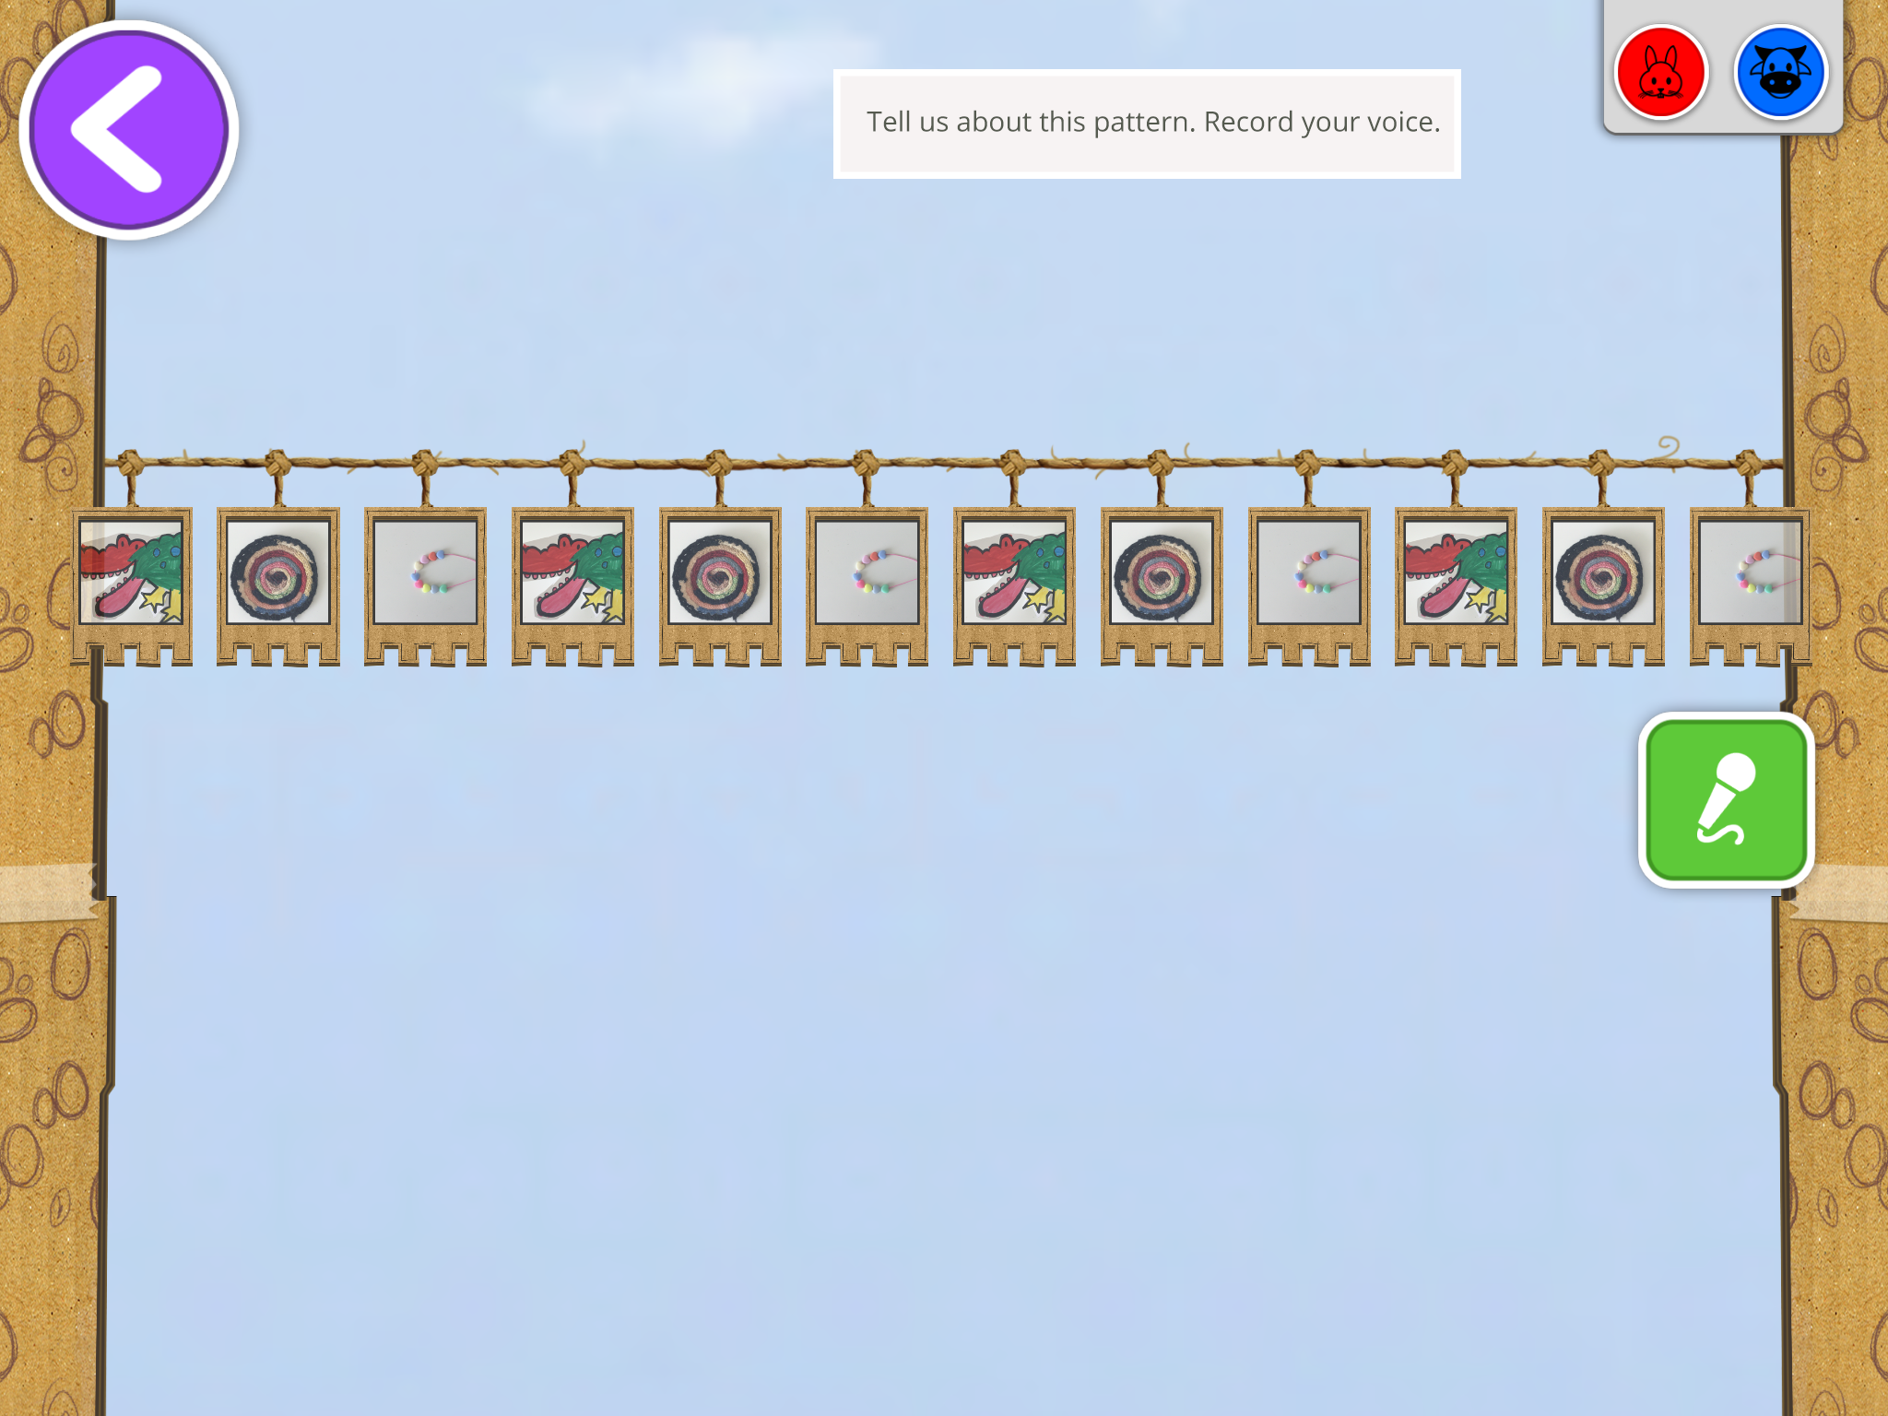
Let’s Decorate- Patterning
Notes:
The final activity is the let’s decorate activity.
Here children get to help one of the ELSA characters decorate the cubby.
Notice here that the child has created a pattern using their own art work – again the children can use the camera to take photos of things they (you) want them to make patterns with – they can then use the microphone to record the pattern they have made – which will be available for you to view in the educator app for each child.

Slide 25
Let’s Play
Next activities will engage with two of the four areas of conceptual development
Patterning – Press Here Game – Variation 1 (Using the holes)
Representing – Press Here Game – Variation 2 (As per instructions)
We will all play the Press Here Game
Notes:
PRESS HERE GAME = Patterns Game
Game One - using the hole punch cards, create a pattern and get your partner to copy | extend | fix | insert missing element. They then translate the pattern into a movement pattern or a sound pattern.
Game Two - As per game instructions except you must create a repeated pattern within the confines of the board - discuss why. Only use 6 slot cards where a pattern can be made - plus a few random ones where it can’t to test them (THINK ABOUT THIS MORE).
OK – let’s actually use the iPad – please turn down the sound on your iPad and follow as we work through it together.

